Slide 1
Sjogren’s Syndrome :
Evolving Therapies
Robert Fox, MD, PhD
Carla Fox, RN
Scripps Clinic and Research Foundation
and
Kaizen Brain Research Center
La Jolla, California USA

Slide 2
Thank you for inviting me to PANLAR
Disclosures:
A Consultant to Novartis and to Eli Lilly
All slides will be posted on my website:
robertfoxmd.com

Slide 3
Take home point - 1
The primary outcome measure in clinical trials
is the ESSDAI
(European Sjogren’s Syndrome Disease Activity Index).
This is a weighted scale involving different organ systems.
A clinically significant improvement is >2.5 units.
However, the ESSDAI is “flawed” –
particularly in the neurologic domain.

Slide 4
Take home point – 2
The secondary endpoint in clinical trials is the ESSPRI (European Sjogren’s Syndrome Patient Reported Index).
This is a self-reported measure about patients’ quality of life.
Three units of improvement are considered clinically significant.
(The ESSPRI is also unreliable, and also will have to be rewritten.)

Slide 5
Take home point – 3
The New Outcome Measures for Clinical trials
are weighted measures called “STAR” and “CRESS.”
These are composites of ESSDAI and ESSPRI --
and will have to be re-weighted.
The committee performing these adjustments is called “Necessity.”

Slide 6
With these “criteria” as background…
Let us look…
at some of the older trials of DMARDs,
also the results with Rituxan,
And let us look at recent Phase II-b studies
which are entering Phase III.

Slide 7
Since 2004 -- we have seen many drug trials
The failure of anti-TNF’s after initial reports of success
The initial enthusiasm over abatacept (anti-CD40)–
then two failed phase III trials
and
The use of rituximab for extraglandular manifestations,
even though it has not been approved by the FDA.

Slide 8
Rituxan (anti-CD22)
is still our standard ”go to” drug (at Scripps Clinic in San Diego)
for extraglandular manifestations --
rituximab (TRACTISS)
(Tears)
2020
2021
rituximab
Open label-Pipje (2005)
For Fatigue-Dass (2008)
Double blind for FDA-
St. Clair (2008)
Meijier (2008)
Rituxan
Verstappen (2017)
2005
2007
2006
2008
2009
2010
2016
2017
2018
2019
2020
2021
2011
2015
2022

Slide 9
Rituximab (anti-CD22) antibody
All studies showed B-cell depletion
and improved extra-glandular manifestations.
The ESSDAI improved more than 2.5 units.
However, none of the studies showed significant improvement
in the patients’ glandular (ocular or oral)
or constitutional symptoms (pain, fatigue, or brain fog).

Slide 10
Since rituximab
did NOT improve the patients’
Global Assessment of Symptoms,
it was not approved by the FDA
So the key need is to improve the ESSDAI (extraglandular)--
and also to
improve the patients’ subjective Quality of Life (QoL)
as measured by the Physician and Patient global assessment.

Slide 11
Take home point – 4
Sjogren’s Syndrome is composed of
4 basic subgroups (endotypes).
These endotypes are defined by their unique
clinical features.
The FDA will probably approve a drug for each specific endotype
rather than requiring the drug to work on ALL endotypes.

Slide 12
Clinical Subtypes of Sjogren’s
Based on patients’ symptoms of dryness, fatigue and pain
(from Sjogren’s US Registry of 1,454 patients)
the Endotypes include:
Low symptom burden (10%)
Dry, Low Pain (30%)
Dry High Pain (23%)
High Symptom Burden (37%)
McCoy et al. Arthritis & Rheumatology (2022) 74: 1569

Slide 13
NO proteomic signatures
of lymphocytes, dendritic or myeloid cells
have been successful in identifying patients
who are likely to have a flare of their ESSAI.
Verstappen et al., Front Immunology 2021; 12:681941

Slide 14
Take home point - 5
Recent Phase IIb trials of several drugs
have been sufficiently promising
that they are now entering Phase III trials.

Slide 15
Take home point - 6
These 4 drugs showed an improved ESSDAI
and
were tending towards an improved ESSPRI.
      Ianalumab – an anti-BAFF receptor antibody that also depletes B-cells
      dazlobip -- a fusion protein targeting Anti-CD40 Ligand
      remibrutanib -- a Bruton Tyrosine Kinase Inhibitor
      tetitacept -- a fusion protein targeting BAFF and April

Slide 16
It is hoped that in larger Phase III trials
these drugs may show improvement
in a particular subgroup (endotype)
of patients in their
Patient and Physician Global Assessment
while maintaining their improved ESSDAI.

Slide 17
.
I will concentrate on
Ianalumab
In large Phase IIb studies (both I.V. and subcutaneous dosing),
it was the only drug that went “beyond rituximab.”
a. There was significant improvement
in the ESSDAI (primary endpoint) >2.5 AND
b. Significant improvement in the salivary flow (part of ESSPRI)
as well as in the Patient and Physician Global Assessment.

Slide 18
Ianalumab
has a dual mechanism of action
a. It depletes B-cells by an
Antibody Dependent Cellular Cytotoxicity mechanism (ADCC) mediated by NK cells
and
b. It blocks the BAFF-Receptor on B-cells.

Slide 19
Antibody Dependent
Cellular Cytotoxicity (ADCC)
        IgG1 antibodies become glycosylated
        at a critical Asparagine residue
in the CH2 domain of the Fc receptor.
        Ianalumab is an IgG1 antibody --
and has been genetically engineered
to have 100 times more potent ADCC activity.
      This results in enhanced B-cell depletion.

Slide 20
Ianalumab
is directed against
the B-cell Activating Factor (BAFF) Receptor
BAFF is a factor that controls B-cell survival and maturation.
By inhibiting the binding of BAFF to its receptor (BAFF-R),
Ianalumab prevents the survival of B-cells
and their production of pathogenetic antibodies.

Slide 21
Now –
back to
randomized double-blind Phase IIb studies …

Slide 22
Methods
293 participants were randomly assigned
to receive subcutaneous doses of placebo or ianalumab
every 4 weeks.
Patients were 18–75 years old
with moderate to severe disease activity
(ESSDAI score ≥6)
and symptom severity (ESSPRI score ≥5).
.

Slide 23
This data was published in
The Lancet (2021)
Safety and efficacy study of
subcutaneous Ianalumab
in patients with primary Sjögren’s Syndrome:
a randomized, double-blind, placebo-controlled,
Phase 2b dose-finding trial
Bowman, S., Fox, R., Dorner, T., Huebner, H. et al
published online Nov 30, 2021; doi.org/10.1016/50140-6736

Slide 24
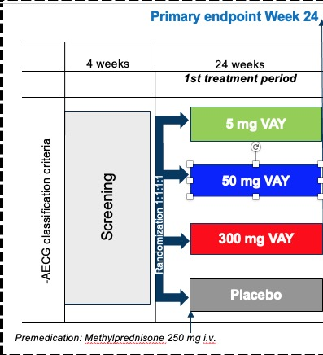
Multiple Dose Phase II-b Trial of Ianlumab
Patients
were randomized
to each dose
of drug
or placebo
given subcutaneously
every 4 weeks.

Slide 25
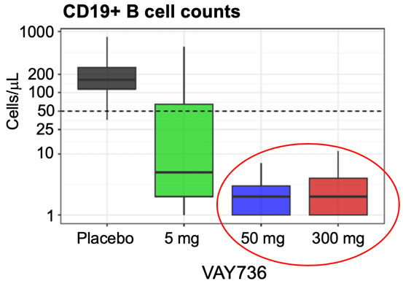
Notice that the 50 mg and 300 mg doses
both showed essentially
equivalent depletion in B-cells

Slide 26
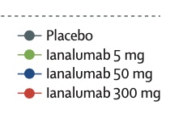
The Ianalumab 300 mg dose provided the best ESSDAI result.

Slide 27
And only the Ianalumab 300 mg dose improved the ESSPRI
This was because the
50 mg dose
only partially blocked the BAFF-Receptor,
while the
300 mg dose
fully blocked the BAFF-Receptor.

Slide 28
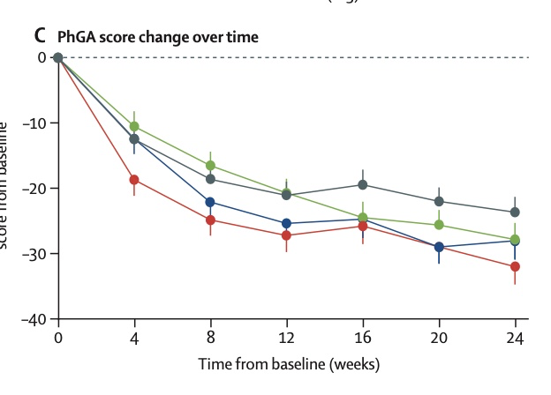
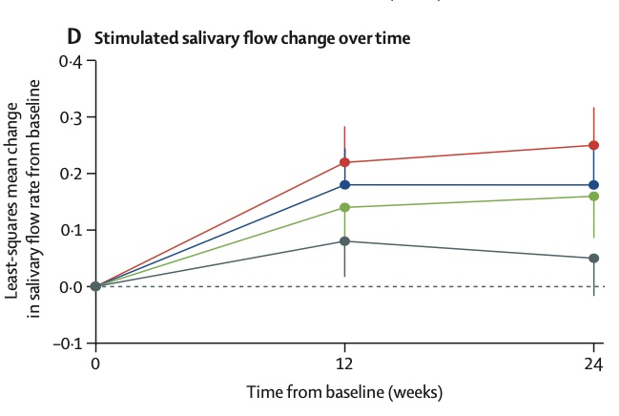
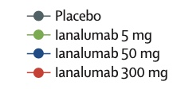
There was an improved Physician Global Assessment and Saliva Flow on
Ianalumab 300 mg Dose

Slide 29
Although the ESSPRI was borderline, the FACIT–F was IMPROVED at the 300 mg dose

Slide 30

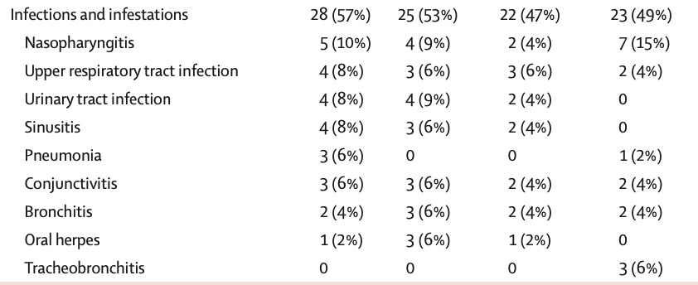
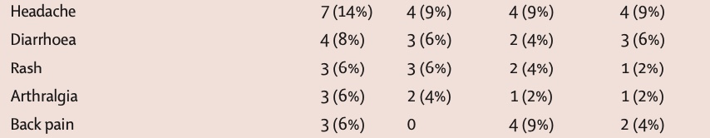
Side Effects were equivalent in all groups.

Slide 31
One surprising finding was that fatigue and brain fog were NOT correlated with Interferon signatures.

Slide 32
Take home point - 7
-- Cost Effectiveness --
A new therapy will have to show
superiority to available drugs
like rituximab.
The FDA will probably give approval
if the drug shows efficacy
in 1 or 2 endotypes of Sjogren’s patients.

Slide 33
Looking at all the drugs entering Phase III trials,
only Ianalumab has gone beyond rituximab
by showing improvement in
ESSDAI
ESSPRI (saliva flow)
and
Global Assessment (both by Physician and Patient)

Slide 34
SUMMARY – 1
Several Drugs have completed Phase IIb trials
in Sjogren’s Syndrome with improved ESSDAI
and are entering Phase III trials.
These drugs
have met their primary endpoint
of lowering ESSDAI by >2.5 points,
compared to placebo.

Slide 35
SUMMARY – 2
Only Ianalumab had a large number of patients
(in both the I.V. and the subcutaneous dosing trials).
Both of these trials showed
improvement of the primary endpoint --
and ALSO improvement of
Physician and Patient Global improvement
(PhGA and PGA).

Slide 36
SUMMARY – 3
These trials did show a very high placebo response,
probably because of
the high-dose corticosteroid
given as a pre-medication.
The safety profile of Ianalumab was acceptable.

Slide 37
SUMMARY – 4
Other drugs were also in trial --
but did not fulfill significant ESSDAI or ESSPRI.
Leniolisib
Petersicatib
Filgotinib
Lanraplenib
Tibrabrutinib
RSLV-132. Fc-fusion protein RNAase
Baminercept a fusion protein blocking lymphotoxin β receptor IgG fusion protein (LTβR-Ig)
Prezalumab. IgG2 type monoclonal antibody designed to bind to ICOS-Ligand
Bruton
Tyrosine
Kinase
Inhibitors

Slide 38
Thank you for inviting me to this inspiring PANLAR Congress in your beautiful city
I look forward to greeting you at the next ACR
which will be held in
my home city of San Diego, California
later this year.
Our clinical hospital:

Slide 40
One approach was to look at different Sjogren’s Syndrome patients
and divide them into different clinically defined subsets
(called Endotypes).
For example, a patient with extraglandular symptoms
might have a better chance of improved ESSDAI response to a drug
than a patient with pain, fatigue and brain fog.

