Slide 1
Rituximab: A Biologic agent with multiple uses
Robert I. Fox, M.D., Ph.D.
Scripps Memorial Hospital
Scripps/XiMED Medical Center
La Jolla, California
robertfoxmd@mac.com

Slide 2
Disclosure: I am a consultant to Genentech and Biogen
Rituximab is currently co-marketed by Biogen Idec and Genentech in the U.S., by Hoffmann–La Roche in Canada and the European Union, Chugai Pharmaceuticals, Zenyaku Kogyo in Japan and AryoGen in Iran
Clinical trials were done at Scripps for FDA approval-since IDECC is across the street

Slide 3
Rituximab
The antibody binds to CD20.
CD20 is widely expressed on B cells, from early pre-B cells to later in differentiation, but it is absent on terminally differentiated plasma cells
CD20 does not shed, modulate or internalize
Although the function of CD20 is unknown, it may play a role in Ca²⁺ influx across plasma membranes, maintaining intracellular Ca²⁺ concentration and allowing activation of B cells.

Slide 4
CD20

Slide 5
Rituximab

Slide 6
Rituximab
The Fc portion of rituximab mediates antibody-dependent cellular cytotoxicity (ADCC) and complement-dependent cytotoxicity (CDC).
Rituximab has a general regulatory effect on the cell cycle.
It increases MHC II and adhesion molecules LFA-1 and LFA-3 (lymphocyte function-associated antigen).
It elicits shedding of CD23.
It downregulates the B cell receptor.
It induces apoptosis of CD20+ cells.

Slide 7
Dosing-1
The approved dosing in RA is 1 gm at t=0 and 2 wks. Premedication with steroids and benadryl
The use of high dose steroids in placebo arm required by FDA confounded the results
The results in RA with 500 mg were almost as good as 1 gm, so IDECC filed for higher dose although cost was twice as high

Slide 8
Dosing-2
In giant cell arteritis, the dosing is 375 mg/meter square
In lymphomas—it remains 375 mg/meter square but no studies have shown any difference
The timing for second or later dose remains unknown although standard at 6 months
In our SLE and SS, dosing may be very infrequent

Slide 9
Dosing-3
It appears that combination of rituximab plus MTX (7.5 -15 mg/wk) gives improved response to rituximab
Pharmacokinetics indicate this is probably due to improved bio-availability of rituximab due to MTX inhibiting drug clearance in spleen by Fc receptors

Slide 10
Adverse events-1
Infusion reaction-may be related to rate of infusion
Cytokine release syndrome in leukemias
Tumor lysis syndrome, causing acute renal failure
Infections
Hepatitis B reactivation
Other viral infections including zoster reactivation
Progressive multifocal leukoencephalopathy (PML)
Pulmonary toxicity

Slide 11
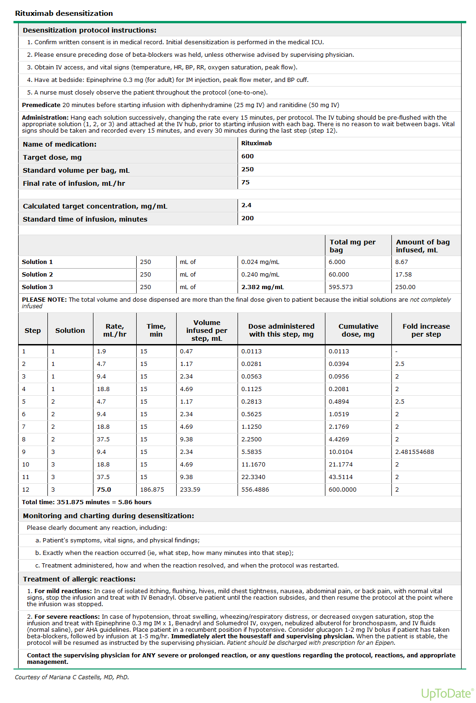

Slide 12
Toxicity
Two patients with systemic lupus erythematosus died of progressive multifocal leukoencephalopathy (PML) after being treated with rituximab.
PML is caused by activation of JC virus, a common virus in the brain which is usually latent. Reactivation of the JC virus usually results in death or severe brain damage

Slide 13
Rituximab
trade names Rituxan, MabThera and Zytux
A chimeric monoclonal antibody against the protein CD20, which is primarily found on the surface of immune system B cells.
Rituximab destroys B cells and is therefore used to treat diseases which are characterized by excessive numbers of B cells, overactive B cells, or dysfunctional B cells.
This includes many lymphomas, leukemias,transplant rejection, and autoimmune disorders

Slide 14
History-1
Rituximab was developed by IDEC Pharmaceuticals under the name IDEC-C2B8. The U.S. patent was issued in 1998 and will expire in 2015
Several bio-similar drugs are currently in use and more are in development to be cheaper in cost to patient

Slide 15
History-2
Rituximab was approved by the U.S. Food and Drug Administration in 1997 to treat B-cell non-Hodgkin lymphomas resistant to other chemotherapy regimens in studies by Dr. Antony Lopez.
Rituximab, in combination with CHOP chemotherapy, is superior to CHOP alone in the treatment of diffuse large B-cell lymphoma and many other B-cell lymphomas.
In 2010 it was approved by the European Commission for maintenance treatment after initial treatment of follicular lymphoma

Slide 16
History-3
Anti-CD20 was first developed in Ron Levy’s lab at Stanford, where I was a post-doc
The dose of 375/square meter was arbitrarily dosed on the amount of drug we had available for the FDA requirement of 16 patients
The first patient at Scripps was a Sjogren’s patient (indeed—Josephine Scripps) who had Sjogren’s in 1990—years prior to approval

Slide 17
Autoimmune diseases-1
Rituximab has been shown to be an effective rheumatoid arthritis treatment in three randomised controlled trials and is now licensed for use in refractory rheumatoid disease.
^{s}In the United States, it has been FDA-approved for use in combination with methotrexate (MTX) for reducing signs and symptoms in adult patients with moderately to severely active rheumatoid arthritis (RA) who have had an inadequate response to one or more anti-TNF-alpha therapy.
In Europe, the license is slightly more restrictive: it is licensed for use in combination with MTX in patients with severe active RA who have had an inadequate response to one or more anti-TNF therapy

Slide 18
Autoimmune diseases-2
rituximab is widely used off-label to treat difficult cases of:
multiple sclerosis,
systemic lupus erythematosus
Sjogren's syndrome
Chronic inflammatory demyelinating polyneuropathy
autoimmune anemias

Slide 19
Other autoimmune diseases that have been treated with rituximab
autoimmune hemolytic anemia
pure red cell aplasia
idiopathic thrombocytopenic purpura (ITP) Evans syndrome,
granulomatosis with polyangiitis, formerly Wegener's)

Slide 20
Other autoimmune diseases that have been treated with rituximab
bullous skin disorders (for example pemphigus, pemphigoid]
type 1 diabetes mellitus
Anti-NMDA receptor encephalitis
Devic's disease,
Graves' ophthalmopathy

Slide 21
IgG4-related diseases
Autoimmune pancreatitis (AIP)
Retroperitoneal fibrosis
Mikulicz syndrome
Of note, these IgG4-RD are mediated by
CD20 negative, CD19-positive plasmacytic cell
It is assumed that removal of CD20 positive precursors of CD19 plasmablasts is the mechanism

Slide 22
Other anti-CD20 monoclonals
ocrelizumab, humanized (90%-95% human) B cell-depleting agent.
ofatumumab (HuMax-CD20) a fully human B cell-depleting agent.
Third-generation anti-CD20s such as obinutuzumab have a glycoengineered Fc fragment (Fc)[with enhanced binding to Fc gamma receptors, which increase ADCC.
Modifications in the variable regions^{[38]} can enhance apoptosis.

Slide 23
The mechanism is a bit more interesting
Removal of B-cells causes and excess of circulating ligands including IL-2, BAFF, and IL-10
This triggers a round of apoptosis as immune system tries to adjust homeostasis
Activation induced cellular apoptosis-in which over 90% of the stimulated cells are killed and only certain memory cells remain due to Th
This is like re-booting your computer

Slide 24
The best predictor
B-cell depletion occurs even if no clinical response
The best predictor is the emergence of CD4+, CD25+ Treg (FoxP3) cells
Thus the predictor of response is the immune system is altered from inflammatory to regulatory cells
B-reg cells (CD22 subset) are being studied

Slide 25
From the IgG4-RD
It is likely that the target in these disorders as well as SLE or Sjogren’s is actually the plasmacytic dendritic cells
The plasmacytic dendritic cell plays a key role in type 1 interferon regulation

Slide 26
Central to the concept of B cell depletion therapy
pathogenic B cell clones and their autoantibody products might be engaged in a vicious cycle of self-perpetuation
B-cell autoimmunity requires T cell autoreactivity.
The interruption of such a cycle would restore immune tolerance and, therefore, might allow sustained benefit.

Slide 27
Summary
The simple story is CD-20 B-cell depletion
This is clearly only part of the story
The removal of precursor CD20 cells is shown in IgG4-RD
The alteration of T-cell repertoire indicates that the “homeostasis” is reset when you create activation induced cell death

