Slide 1
Thoughts About Going Forward
आगे जा रहा है विचार
आगे जा रहा है विचार
Robert I. Fox, M.D., Ph.D. Scripps Memorial and Research Foundation La Jolla, California, USA RobertFoxMD@mac.com
Sjogren’s Special Interest Group (SIG)

Slide 2
I was asked a similar question by the Europeans back in 1986 at the first Sjogren’s Conference in Copenhagen. I was the external advisor to the new EULAR group. That was at time of the Chernobyl explosion– and now the Europeans have organized their cohort of patients and have the most papers accepted.
Background:
I was recently asked the question:
“Why do Indian Academic Centers have such a
difficult time getting their papers published
when they have such incredible patient populations?”

Slide 3
Your studies must be set up to test a hypothesis— not just “data” mine your clinical charts.
Short Answer
to “Clinical Relevance”
in 2015

Slide 4
Strengths of Indian Rheumatology – 1
a) Outstanding rheumatologists,
ophthalmologists, and neurologists
b) Patient population including many who
are computer literate.

Slide 5
c) Excellent computer science and IT support. d) Absence of “medical-legal” restraints that interfere with patient care. e) Desire to become a center for clinical and therapeutic excellence.
Strengths of Indian Rheumatology -2

Slide 6
Goals -- to find these answers: * Is Sjogren’s an important disease or just an annoyance? * How do we best treat systemic (extra-glandular) manifestations? * What is the role of new medications and bio-similars medications?
Organize your patient data base.
This is an opportune time,
since new algorithms
are being established due to
the AECM and SICCA controversy.

Slide 7
Your first major objective: To identify all Sjogren’s patients in other clinics: *hematology, *neurology *pulmonary *nephrology who are currently misdiagnosed as SLE due to their positive ANA
Is Sjogren’s Syndrome an important disease?

Slide 8
Computer search the clinical laboratory for all SS-A(+) patients to identify: 1. the current treating doctor IF in Hematology, Orthopedics, or Neurology clinic 2. Checking other laboratory values of anemia, renal failure 3. Cross-reference for laboratory tests in Radiology (CAT scans or MRI) 4. Medications such as DMARDS or Biologics to pick up the;: vasculitis, lymphoma, and other systemic manifestations
Methods to Locate the entire cohort of SS patients

Slide 9
a) Announce a prize for best computer program by an IT student b) Ask computer clubs to “group source” the problem c) Determine if members of SS member groups are interested in participating in writing the program
Use Original Approaches since you are already busy:

Slide 10
1. Patient educational level: proven as a surrogate for education and compliance—best predictor in RA. 2 Loss of time away from work due to eye symptoms or systemic illness. 3. Loss of time away due to fatigue. Offer prize to student to write an app for their smart phone, so patient can self-report to a web data base.
Data to be included in medical record

Slide 11
1. Ocular pain/dryness is number one cause of visit to ophthalmologists. 2. Loss work is estimated at $200 billion due to “eye strain.” 3. Eye symptoms correlate poorly with eye pain -- so we also record “Ophthaine Score.”
Examples in US, Japan and UK—
where people sit in front of computers all day
with decreased blink rate-- (90% blink decrease)
and where humidity is low in air-conditioned buildings

Slide 12
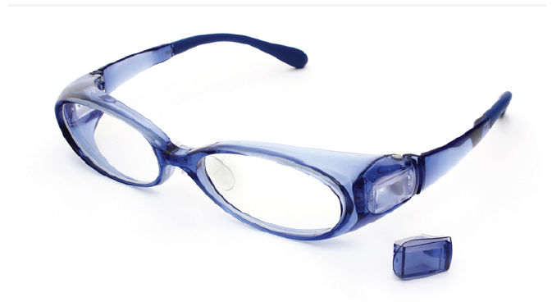
Develop your own moisturizing glasses
similar to Jinn in Japan
Offer a prize to an engineering student
to develop India’s own brand. They should be “computer” glasses focal length.
Note: the Japanese facial structures are different those in India, so the JINS will not work in India.
Correlate with improved productivity and comfort.

Slide 13
1. ESSDAI (modified) for India. Goal is to determine clinically significant change (Delphi method). 2. Have student write app for iPhone (patient and physician). 3. Only 10% of patients need to be competent for proof of concept.
Going Forward: Treatment -- 1

Slide 14
4. Develop collaboration with ultrasound experts to evaluate gland. 5. Do not make this a bedside test. 6. Collaborate with engineering and computer scientists to develop the best system, as this will be a key pillar in next decade.
Going Forward: Treatment - 2
4. Develop collaboration with ultrasound experts to evaluate salivary gland. 5. Do not make this a bedside test. 6. Collaborate with engineering and computer scientists to develop the best system, as this will be a key pillar in next decade.

Slide 15
7. Make sure oral candida is scored and treated before treatment plans are formulated and initiated. 8. Correlate with saliva biomarkers and patient oral HAQ (Quality of Life scores). 9. Correlate with dental scores and extractions.
Going Forward: Treatment - 3

Slide 16
10. Recognize the new ocular staining score. 11. Adapt iPhone to measure OSS. 12. Determine clinical significance of OSS and “Ophthaine” score.
Going Forward: Treatment - 4

Slide 17
13. Capture data on sleep and depression. 14. Capture data on OTC meds. 15. Work with Multiple Sclerosis experts to understand the intra-cerebral pathways— probably involving microglial cells and their biomarkers.
Going forward: Treatment -- 5
Chronic Fatigue

Slide 18
1. Who will pay for this? 2. Who will publish the results? Both government grants and NGO (non-government organization) when you demonstrate it is significant disease Local grants from pharmaceuticals. 3. Journals will publish this data from well designed hypotheses, methods and results
Summary ---1

Slide 19
3. Predict reduced ophthalmology costs and increased productivity. 4. Determine if the pain (oral or ocular) is due to dryness or “central pain.” 5. Adjust outcome measures to correlate with salivary flow.
Summary - 2

Slide 20
6. Identify patients with high ESSDAI score for clinical trials. 7. Contact manufacturers of both Big Pharma and Biosimilar Manufacturer for trials with your new data bases and iPhone-based data collection systems.
Summary - 3

Slide 21
मुझे आमंत्रित करने के लिए धन्यवाद मुझे आमंत्रित करने के लिए धन्यवाद Mujhē āmantrita karanē kē li'ē dhan'yavāda.
Thank you for inviting me.
All slides are listed on
RobertFoxmd.com
(on your computer but not iphone)

Slide 22
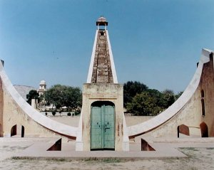
At Salk Institute (next to Scripps), the fountain is set so that sun sets at summer solstice but at each Equinox, the sun travels only to each tower. Louis Kahn’s gift of our own little Stonehedge or India’s Jaipur.

