Slide 1
Sjogren’s Syndrome and Migraine:
An interface of
Autoimmunity and Neurovascular
Systems

Slide 2
Robert I. Fox, MD., Ph.D.
Scripps Memorial Hospital and Research Foundation-Ximed
La Jolla, CA 92037 robertfoxmd@icloud.com

Slide 3
Learning objectives:
1. Recognize a high association of migraine and Sjogren’s syndrome
2. Identify migraine as a neurologic manifestation of Sjogren’s Syndrome and Systemic Lupus (SLE)

Slide 4
For this audience
One of the key questions is whether migraine should be considered an autoimmune disease?
? Features of innate immunity
? Features of acquired immunity or
? A new arm of “autoimmune” that involves a combination of pathways

Slide 5
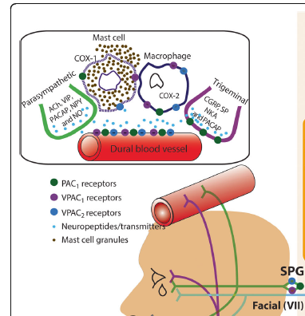
The initial target appears to a specific region of dural blood vessel in a peripheral nerve (VII): a. autoinflammatory such as “gout-like” b. innate receptor to cytokine or neurokine
(uveitis) c. antibody driven from gut-immune axis

Slide 6
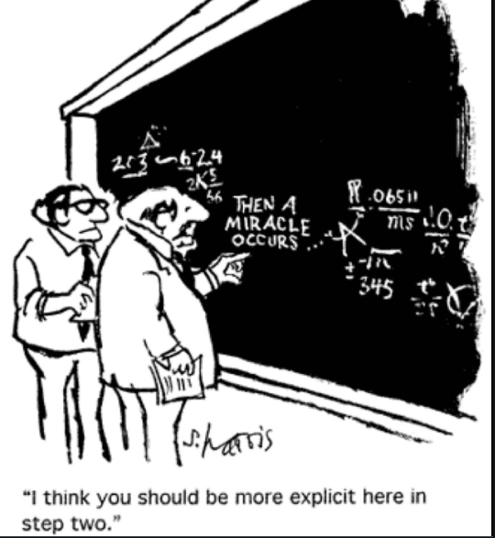
Also the perpetuation and spreading
Of the migraine
likely involves immune mediated factors

Slide 7
It is likely a combination of these processes, as we now envision the immune system as part of of the “Danger Signal” response
This general model was first presented by Matzinger et al at Salk Institute in 1994
It is now the current direction to link the immune, endocrine, infection and gut-neuro-immune axis

Slide 8
One of the hallmarks of autoimmune disorders is their association with other autoimmune disorders.
This helps us look for common pathogenetic pathways.
I will discuss Sjogren’s syndrome as a particular example of an autoimmune neuro-endocrine disorder

Slide 9
Sjogren’s Syndrome
Dry eyes and Dry mouth due to lymphocytic infiltrates of the lacrimal and salivary gland
Characteristic autoantibody including Antinuclear Antibody (ANA) and antibody to a particular autoantigen called SS-A (also known as Ro)
Extra-glandular symptoms including skin (vasculitis), lung (interstitial pneumonitis), kidney (interstitial nephritis), increased frequency of lymphoma
Neurological manifestations including both peripheral neuropathy and central neuropathy (NMO, cranial nerve palsies) that are all characterized by lymphocytic infiltrations.

Slide 10
Sjogren’s has both “glandular” and “extraglandular” features
“Glandular features” in SS refer to:
dry eyes (lacrimation),
dry mouth (salivation) and
constitutional complaints of fatigue and cognitive brain fog.
These respond poorly to treatment and we look forward to
Interacting with neurologists to develop better therapies

Slide 11
Common Misconceptions about Sjogren’s
a. The dryness is NOT due to total destruction of the glands.
Over 50% of the ducts and acini remain—in contrast to type I diabetes where gland destroyed (next slide)
b. The neural innervation of the glands remains detectable
c. However, the gland is dysfunctional—as the inflammatory system has “denervated” the gland

Slide 12
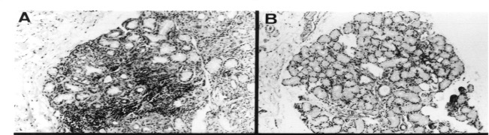
The Dryness is the result of
Lymphocytic Paralysis of Lacrimal and Salivary Glands
Residual acini and Ducts
lymphs
Sjogren’s
Normal

Slide 13
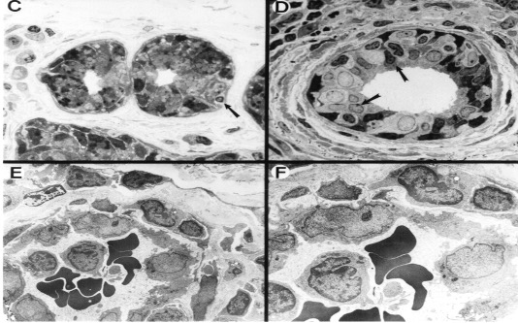
Glandular dysfunction is due to lymphocytic infiltration of the glands (c and d).
But it begins with lymphocyte ”homing” to high endothelial venules (e and f)

Slide 14
Parasympathetic
fibers
Muscarinic M3
Receptors on
The gland

Slide 15
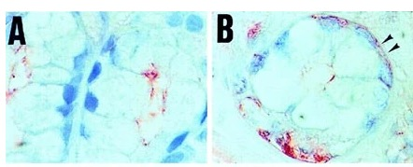
The local inflammation due to cytokines and metalloproteinases prevents the gland from functioning, as shown by disoriented aquaporin molecules
normal
SS biopsy

Slide 16
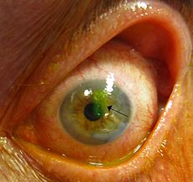
The eye may develop corneal abrasions and perforation of the globe (fluorescein)

Slide 17
Extraglandular features in SS patients— these features differ from SLE patients
Sjogren’s is a lymphocytes aggressive disease with interstitial lymphoid infiltrates
Interstitial pneumonitis rather than pleural effusions
Interstitial nephritis rather than glomerulonephritis
High incidence of non-Hodkins lymphoma (40 fold increased risk) in comparison to either RA or SLE

Slide 18
Sjogren’s syndrome and migraine
Sjogren’s has a higher incidence of migraine (with and without aura) than either RA, SLE or Scleroderma
Sjogren’s has an incidence of trigeminal neuralgia as high as scleroderma

Slide 21
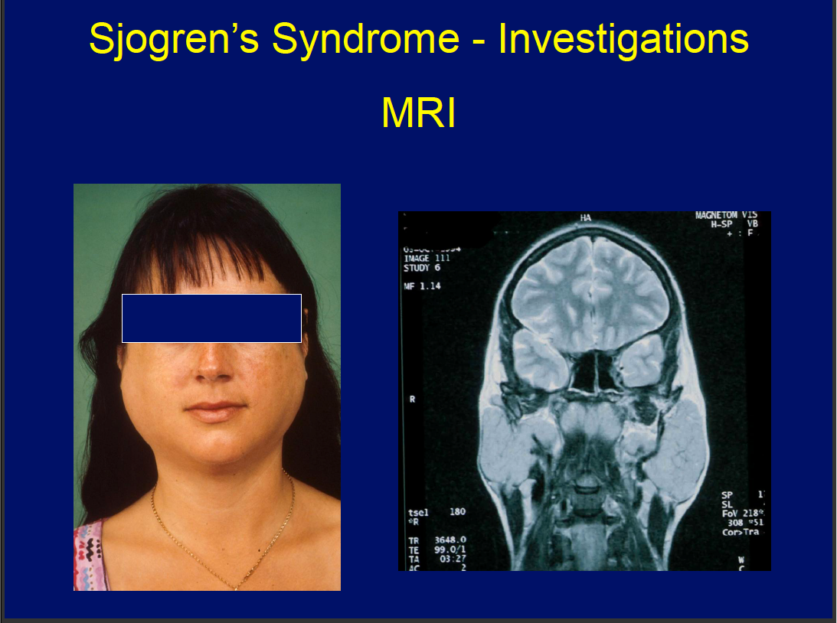
Neurologic Manifestations of Sjogren’s Syndrome Pathogenesis
Small-vessel vasculopathy or frank leukocytoclastic vasculitis [4,5]
●Dorsal root ganglionitis [6,7]
●Cryoglobulinemia [8]
●Demyelination [9]
●Myelitis [10]
●Antibody-mediated autonomic dysfunction [11,12]
Refs from Fox, R in UpToDate

Slide 22
Let us go back to the other extraglandular features of Sjogren’s Syndrome a. Although there are autoantibodies in SS, the main pathogenetic feature is lymphocytic infiltrates and local release of cytokines and neurokines b. Single cell sequencing shows a high incidence of clonal expansion of B-cells and T-cells with germ line encoded antigen receptors

Slide 23
Take home point:
We are seeing a “primitive repertoire” of germ line encoded receptors in the T-cells and B-cells in addition to the antigen driven mutations of the acquired immune system

Slide 24
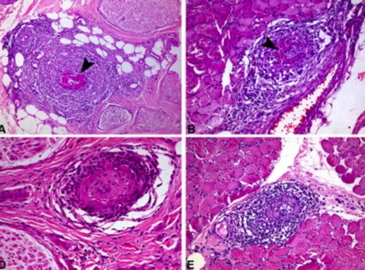
Lymphoctes infiltrate
Large and small vessel to cause vasculitis on nerve biopsy

Slide 25
Small Fiber Neuropathies in SS
Sensory Ataxic Neuropathies
Mononeuropathy Multiplex trigeminal neuralgia
Multiple Cranial Neuropathies
Demyelinating radiculopathy

Slide 26
Sjogren’s also affects Hypothalamic axis
“Chronic autoimmune” stress in SS results in changes involving response of hypothalamic, pituitary and adrenal axis, as well as cortisol metabolism.
MacEwen (1998) N. Eng J. Med 338:171-179

Slide 27
Central Nervous System
Asymptomatic MRI lesion
Optic Neuritis
Transverse Myelitis
NMO Spectrum Disorders
MS like presentations
Cognitive Dysfunction

Slide 28
Migraine in Sjogren’s patients
Rheumatologist rarely consider migraine as an autoimmune manifestation of Sjogren’s syndrome--and we just refer the patient the neurologist or neuro-ophthalmologists
But the association of SS and migraine has been recognized for
many years…

Slide 29
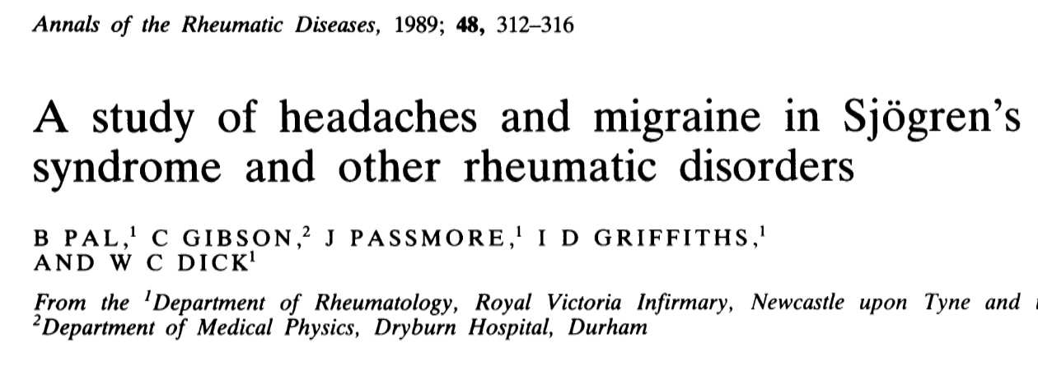
First definitive report in 1989
“A study of headaches and migraine in Sjogren’s Syndrome”
W.C. Dick et al
(Ann Rheum Dis.1989;48:312)
Migraine was diagnosed in 46% of SS patients compared to 11% controls,
12% of RA, and 30% of scleroderma…

Slide 30
And more recently by Hadjev (2008) in the Scandanavian cohort
Headache in primary Sjögren’s syndrome: a prevalence study
Acta Neurologica Scandinavica /
Volume 118, Issue 3 / p. 189-192
In 133 of the pSS patients evaluated,
104 had headache. In contrast, no increase migraine in RA patients.
No association was present between types of headache and the clinical and laboratory manifestations of the disease.
Both migraine and tension-type headache were more common in patients with pSS when compared with healthy controls or RA patients (P < 0.001).

Slide 31
So the question today is whether to add
Migraine to the list of disorders associated with Sjogren’s?
Migraines are so common in SS patients that rheumatologists never stop to think of them as a “disease” manifestation

Slide 32
Migraine is not considered as a neurologic manifestation in the “SS disease index score”
(ESSDAI) used to evaluate therapy

Slide 33
Similar changes in SS and migraine on Confocal Microscopy
Corneal sub basal nerve plexus changes in patients with episodic migraine: an in vivo confocal microscopy study
J Pain Res. 2019; 12: 1489–1495. PMCID: PMC6526177 Published online 2019 May 13. doi: 10.2147/JPR.S196705 PMID: 31190959

Slide 34
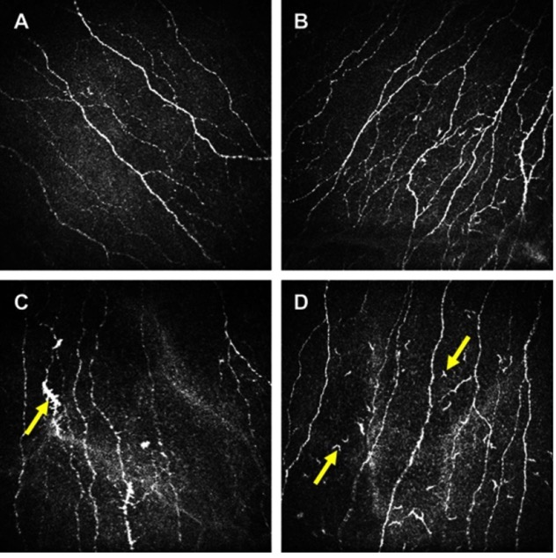
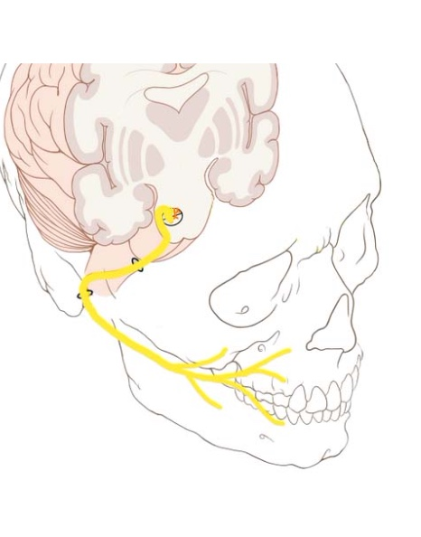
Confocal microscopy show similar changes in both SS or
Migraine patients
A-normal
B. SS patient (tortuosity)
C. Migraine;
D. Langerhans
cells (an immune cell)

Slide 35
The morphologic changes of corneal sub-basal nerve plexus and Langerhans cell aggregation suggest the presence of nerve inflammation in both SS and migraine.
J Pain Res. 2019; 12: 1489–1495. PMCID: PMC6526177
Published online 2019 May 13. doi: 10.2147/JPR.S196705 PMID: 31190959

Slide 36
In summary-1 a. Sjogren’s is a autoimmune disorder that is characterized by aggressive lymphocytes b. The effect on neural innervation is our greatest challenge c. We have not been able to improve either secretory function or cognitive function with immune suppressive drugs

Slide 37
Summary-2
We need to communicate with neurologists and ophthalmologists to understand the mechanisms
Migraine (and MS) have been striking successes in therapy—we need your help

Slide 38
Summary-3
The solution to SS or to migraine will not be simple “innate” or “aquired immune response”
We need to look at the overall
“Danger Signal Model” again

Slide 39
The Basic Tenet of the “Danger Hypothesis is that The Immune System is the 6th Sense
Lymphocytes are “mobile sensors” that the brain sends out to detect “danger”
Matzinger (1994)
Pradeu, T., and Cooper, E. L. (2012). Front. Immunol. 3:287.

Slide 40

The Danger Hypothesis

Slide 41
Central Nervous System
Genetics
Environment
(the gut-immune axis)
Innate immune system encoded to respond to recurring Motiffs (TLRs)
Acquired immune system that
Can use mutation to select
High immunity B and T-cells

Slide 42
Summary-4 When evolution is “in a hurry” mistakes will be made
Given the “survival importance” of vision and “salivation/digestion,” the: a. neural innervation (sympathetic and parasympathetic) of blood vessels and glands b. immune interface with the outside world were thrown rapidly together as man crawled out of the sea

Slide 43
In the particular cases of Sjogren’s and migraine, particular individuals with these diseases were the price for this “too rapid” evolution
The challenge now is to identify these mistakes in hardware and software in order to provide better quality of life

Slide 44
There is insufficient interaction between rheumatologists and neurologists in the field of migraine
a. We read different literature than Neurologists and attend different meetings.
b. While Neurologists have developed a dozen new therapies for their diseases of migraine and multiple sclerosis, there has not been a single new therapy approved by FDA for Sjogren’s
c. Migraine provides an opportunity for a conversation between rheumatologists, neurologists, ophthalmologists and neuro-ophthalmitis

