Slide 1
Diagnostic Criteria for Sjogren’s Syndrome: -- Evolution and Pitfalls --
Robert I. Fox, M.D., Ph.D.
Scripps Memorial Hospital and Research Foundation
La Jolla, California USA
Email: robertfoxmd@icloud.com
Website: robertfoxmd.com
(cannot be accessed by mobile devices for security reasons)

Slide 2
Evidence-Based Treatment of Benign Disease
Benign Symptoms
Dry eyes and Dry Mouth
Arthralgias and Myalgias
Vague Cognitive Changes
Although termed “benign,” they are the most common problems and leading cause of patient complaint and a leading cause of economic loss in SS patients.

Slide 3
Goals:
Understand the reason for the new criteria for Sjogren’s Syndrome (SS).
Recognize the different features in the new criteria.
Identify the weaknesses in the new criteria.
What is the direction for the future?

Slide 4
ACR/EULAR 2016 Criteria for Primary SS

Slide 5
Take Home Lesson - 1
The new criteria are flawed for routine clinical use.
Few patients get a lip biopsy, so diagnosis often rests on the finding of a positive antibody to SS-A.

Slide 6
Take Home Lesson - 2
Many individuals with a positive SS-A do not have Sjogren’s.
Only about 18% of ”normal” individuals with a positive antibody to SS-A will ever develop clinical SS.
Of mothers with anti-SS A and neonatal heart block, only about 20% will ever develop clinical SS.

Slide 7
Take Home Lesson - 3
One of the greatest dilemmas for rheumatologists is: patients sent for evaluation of systemic autoimmune disease, because a positive antibody to SS-A was found.
This is particularly an issue in neurologic manifestations, where an idiopathic neuropathy is sent for immune modulation.

Slide 8
What You Need to Know about New Criteria - 1
The method of ocular scoring is now different and called OCS.
Ophthalmologists do NOT use this OCS method.

Slide 9
What You Need to Know about New Criteria - 2
Ophthalmologists do not need to report Meibomian Gland Dysfunction (MGD) in the new system. This must be changed.
The conservative treatment of ocular or oral symptoms also falls on the Rheumatologist, since often neither the Ophthalmologist or Dentist “has time.”
Treatment of MGD (Blepharitis) and prevention of dental deterioration is important in treatment to increase “productivity” and prevent out-of-pocket expense for dental restorations.

Slide 10
Why do rheumatologists need to know?
Dry or painful eyes is now the most common reason for visit to Ophthalmologist in U.S.
The “loss of productivity” due to eye symptoms is over $170B, since so many work at computers in dry environment
The Ophthalmologists and primary care physicians do NOT have time to address these key issues (including job loss), so the rheumatologist must.

Slide 11
The new Modified Scoring System called Ocular Staining Score (OSS) - It is NOT used by routine Ophthalmologists

Slide 12
For Clinical Studies for FDA
The new ocular staining score and the new whole unstimulated saliva score will be used. The Clinical Research Monitors will be trained to do these measurements— but they will not “match” your routine results from your Ophthalmologist.
The minor salivary gland scores will also be sent to a central “reader” since most biopsies (if ever done) are not read correctly.
Almost 20% of patients with clinical SS and a positive anti-SS-A antibody (done at centers with expertise in biopsy) will have a negative lip biopsy.

Slide 13
The “Divergent” Paths of Clinical and FDA
We recognize that:
The new criteria for SS do not meet the needs of the practicing Rheumatologist.
They will need future revision.
The goal is provide the FDA and Industry with a relatively uniform group of patients on whom a clinical study can be performed.

Slide 14
Back to our world in clinical rheumatology:
Most of our patients now work at computers in low-humidity (air-conditioned) environments or outside where dust and pollution irritate eyes.
In addition to decreased aqueous layer (water and proteins from lacrimal gland), the rate of tear film evaporation depends on the lipid layer on top (made by the Meibomian glands)
Lipid layer
Aquous layer
Corneal surface

Slide 15
The new “buzz” word for economics is “Presentness”—Cost to employers is 10-fold higher than absenteeism
If a patient has a corneal abrasion and has to go home— that is absenteeism.
If a patient has to stop work because their eyes are “tired,” that is lack of “presentness.”
When using a computer, users concentrate on the screen, and
the blink rate goes down by 90%.
When you take a work break, take off your glasses and rub your eyes— that will stimulate the lipid glands and minor glands in the lower lid. This will maintain “presentness” at the workplace.

Slide 16
Ophthalmologists determine best vision—right after a blink. They miss the “blurring.”

Slide 17
What is the Reason for the New Criteria?
A criteria is ideally based on a causative agent — whether endogenous (genetic or epigenetic) and/or environmental factor. This is NOT true in new criteria.
As these etiologic factors are not known… we defined SS based on symptoms (dry eyes/dry mouth), and with evidence of a immune tendency (SS-A or biopsy).

Slide 18
The 2016 (and 2017 revision) criteria were proposed to provide industry with a ”uniform set of patients” for clinical trials.
Then why were new criteria introduced?

Slide 19
Summary of Different Features in the New Criteria
The Ocular Staining Score (called OSS) is done slightly differently, and is not familiar to most ophthalmologists (see my website).
If a patient lacks antibody to SS-A, then a minor salivary gland biopsy is required to fulfil criteria.
It is recognized that the “new criteria” are imperfect and other methods such as ultrasound or further biomarkers have been suggested.

Slide 20
Immediate Problem with New Criteria in Clinical Practice:
Minor salivary gland biopsies are done in less than 5% of SS patients (generally for a clinical trial) (Rasmussen, 2016).
When biopsies are done in clinical practice (including clinical trials), over 50% of biopsies are incorrectly read (Vivino, 2002).
There are expert “consensus” guidelines for reading biopsies, but oral pathologists are not aware of them (Fisher, 2016).

Slide 21
In Clinical Practice …
Outside biopsies are reported by patient as positive, but when the slide is reviewed, it is generally reads “no evidence of tumor, but consistent with Sjogren’s Syndrome.”
The history of a positive biopsy then becomes part of the patient’s history, since the original slides are not reviewed.

Slide 22
Diagnosis of SS is most commonly based on Anti-SS Antibody: How sensitive and how specific is this test?
False negatives for ANA are a problem:
Methods of performing ANA vary— For example, the general screening for ANA is by ELISA,
which is frequently a false negative in SS.
SS-A antigen is labile, and often destroyed during solubilization to make ELISA extract.

Slide 23
Methods to Make the ANA and SS-A more Specific
The screening ANA should be performed by IFA (immune fluorescent method) and note great variability in cell lines (Arth Rheum-2018).
Make sure that your lab uses a ANA kit (such as Hep2000) that expresses SS-A.
If ELISA is used, the ”positive” control antibody should contain documented anti-SS A antibody (as they often only use anti-DNA).

Slide 24
Clinically, if the antibody to SS-A is positive, our main problem is lack of specificity.
Although antibody to SS-A is highly specific (98%), it is NOT sensitive (20%).
Many normal individuals have a positive antibody to SS-A
(see next slide).
The finding of positive SS-A is more commonly associated with the HLA-DR3 extended haplotype than with
Sjogren’s Syndrome.
(Fox, 2011)(Fujisawa, 1990)

Slide 25
The Lack of Specificity of SS-A and Sjogren’s
In a large cohort of ”normal Scandinavian females” who all donated blood samples and then were followed for over 10 years-- less than 20% with a positive anti SS-A will develop SS in a 10-year follow-up (Wen-Tao, 2016).
Only 20% of women with heart block and anti-SS-A who have a miscarriage in their first trimester- will ever develop SS (Buyon, 1998).
The presence of anti-SS-A is more highly correlated with HLA-DR3 than with clinical SS (Reichlin, 1988).

Slide 26
Regarding Anti-SS-A and Sjogren’s
We confuse patients (and ourselves) by quoting data from genetic studies that yield an “odds ratio” (specificity of a positive/negative value).
Both we and patients really want to know the relative risk --- (what is the chance that the patient has SS) -- also called a “Bayesian risk.”

Slide 27
Since the criteria for Sjogren’s includes SS-A…
The finding of antibody to SS-A and the subsequent diagnosis of Sjogren’s thus often becomes “circular logic.”
Hence, an “idiopathic” neuropathy now becomes a Sjogren’s neuropathy, since dryness of eyes and mouth is VERY common.

Slide 28
For example, our most complicated patients present with:
Neurologic problems— that might otherwise be called
idiopathic peripheral neuropathy,
autonomic neuropathy,
demyelinating central lesions.
Lymphoproliferative disorders
Fatigue or cognitive changes
These patients are sent to Rheumatology consult by other specialties when a positive antibody to SS-A is found.

Slide 29
Once an Antibody to SS-A is detected --
The “idiopathic neuropathy patient” is now sent to Rheumatology for immune suppressive treatment.
Although the patient may have an immune relationship, the paradigm for treatment now switches from conservative therapy to aggressive therapy.

Slide 30
Where do we go from here?
Additional biomarkers will be needed to support the diagnosis.
Ultrasound may eventually help, but it is not there yet.
Transcriptional patterns may help us with our difficult problems of severe dry eyes, dry mouth and problems such as “fatigue” and “cognitive” changes.

Slide 31
Treatment of Benign Symptoms
Dry Eyes-1
Aqueous tear deficiency—a myriad of dry eye products are available at the local pharmacy.
They do differ in their “wetting” agent and preservatives.
Some patients require preservative-free tears—
although those are more expensive than multi-dose containers.

Slide 32
Dry Eyes - 2
Attention to other medications that exacerbate dry eyes— particularly BP meds and meds for neuropathy (such as Elavil, etc.) used for fibromyalgia.
Use of Humidifier at night (or at work) as well as air purifier.
Use of computer glasses (that reduce eye strain) and block out flicker and blue light
Use of moisture shields and wrap around sunglasses
Use of moisturized pads (TranquilEyes) for airline trips
We give all patients the website www.dryeyezone.com

Slide 33
Dry Eyes - 3
Approved by FDA are medications:
a. Restasis— topical cyclosporin
b. Xiidra (liftegrast)— inhibits integrin LFA-1 from binding to an adhesion receptor ICAM-1.
Punctal occlusion:
collagen— temporary trial, we have found them unreliable predictors.
silicone— we used to use intracannicular but tiny risk infection.
Must be done by someone with experience in putting these in.

Slide 34
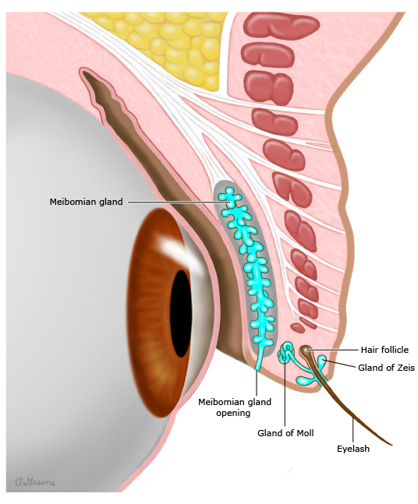
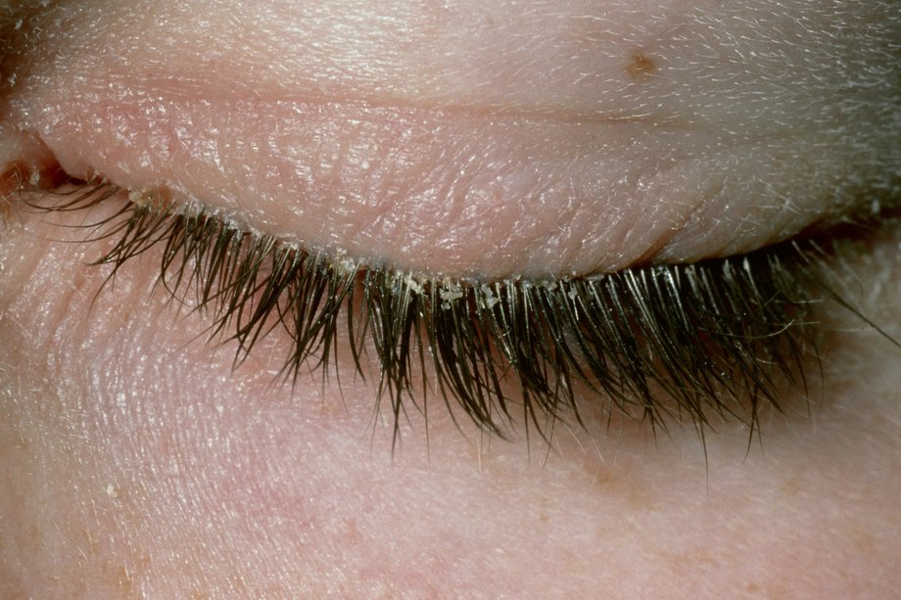
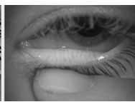
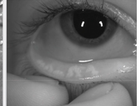
Meibomian Gland Dysfunction (MGD)-Blepharitis

Slide 35
Meibomian Gland Dysfunction
Lid scrubs with dilute baby shampoo (see my website)
Often need azithromycin 250 mg po qd x 5 days (or doxycycline)
Frequently co-exists with rosacea or seborrheic derm (metrocream)
Limit use of eye shadow and use of hypoallergenic make-up

Slide 36
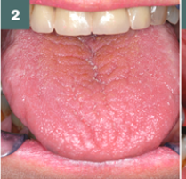
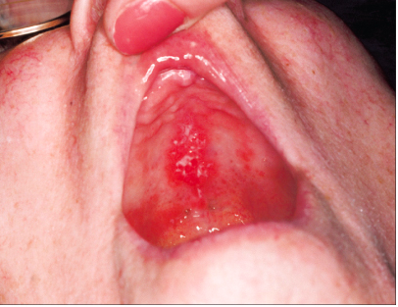
Dry Mouth- Look for Candida nothing will work until you treat the candida

Slide 37
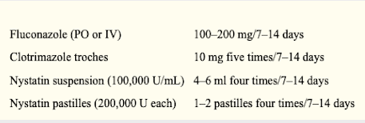
Topical treatments for Oral Candida (see my webpage)

Slide 38
Angular Cheilitis- must also be treated
nystatin (Mycostatin)
ketoconazole (Extina)
clotrimazole (Lotrimin)
miconazole (Lotrimin AF, Micatin, Monistat Derm)

Slide 39
Fatigue and Vague Cognitive Change
Sleep disorder—including nocturia due to polydipsia
Is fatigue worse in AM or PM
Does fatigue improve with exercise
Inflammatory— will associate with high ESR and CRP

Slide 40
Vague Cognitive Change and Fatigue
Highly associated with Sjogren’s and SLE
Need to distinguish from Depression
We have highly skilled computer programmers (we are in a high-tech zone) who are unable to balance their bank accounts.
This is the major complaint and threat to their jobs/marriage.

Slide 41
Measures of Executive Function
Neuropsych testing has shown cognitive changes that are reproducible and distinct from depression.
Neuropsych testing is expensive and frequently denied by insurance.
We use our own brief Neuropsych testing— which we use in collaboration with our colleagues at Salk Institute and functional MRI.

Slide 42
Simplest approach
Serial 7’s subtraction-- and comparison to digits backward
(patients also say their phone number and then say digits in
reverse).
Serial 7’s is a much simpler task and does not require to ”turn off” non-dominant hemisphere.
When digits backward is retained— then it is most likely “executive function” or a processing error— that has similarities to process noted in Attention Deficit Disorder.

Slide 43
To establish a more rigorous baseline
Patients given validated “trail-making 1 and 2”-- time to finish.
Digit substitution tests-- where there is a fixed time to perform test.
These are available online for free and done/scored by patient at home.
Examples shown on next slide.

Slide 45
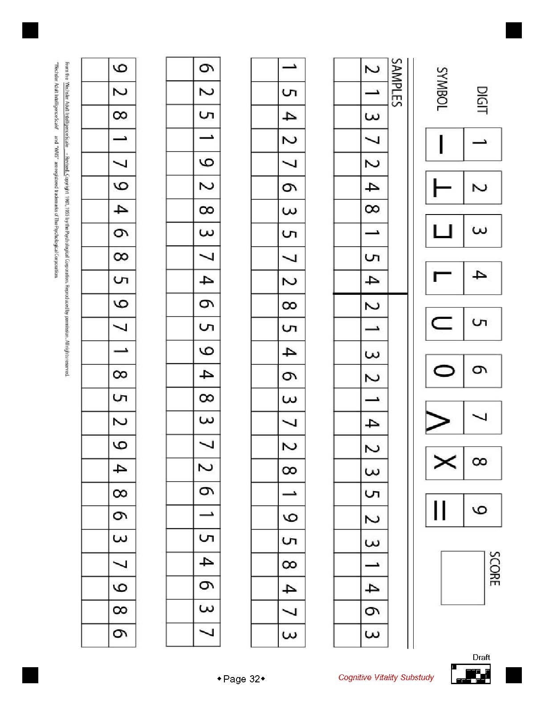
Digit Substitution Test

Slide 46
Our Treatment at Scripps
If depression is present, we use a 3rd generation SSRI-- vortioxetine (sold in U.S. as branded Trentillix or Brentillix).
It has no significant sexual dysfunction or weight gain side effects (which were present in Prozac or Lexapro and prevented compliance in women).
We have found some benefit in low-dose Adderall 20 mg (½ tab in am and ½ tab at noon)— particularly when patient is
at risk of losing job and is in crisis mode)

Slide 47
Summary - 1
New criteria have been adopted to provide the FDA a guideline for clinical trials.
Few patients undergo minor salivary gland biopsies, and there is variability in following the guidelines for evaluation.
SS-A antibody is often missed in screening ANA “ELISA”
(enzyme-linked immunosorbent assay).

Slide 48
Summary - 2
Anti-SS-A antibody is highly correlated with HLA-DR3 extended haplotype in Caucasian populations and with other haplotypes in different ethnicities.
Anti-SS-A antibody is sensitive, but NOT specific.

Slide 49
Summary - 3
Many anti-SS A antibody-positive individuals remain clinically normal.
The finding of SS-A and diagnosis of Sjogren’s have a great tendency to be “circular” logic.

Slide 50
Thank you for inviting me to Waco

Slide 51
Thank you for your time and attention (Skyline of San Diego) Your neighbor on other side of Pacific Ocean

Slide 52
Scripps Clinical Hospital in La Jolla, California

Slide 54
Example of Future Biomarkers in Tear Film

Slide 56
Transcription or methylation not yet useful.

Slide 58
The Problem of Criteria is “Circularity”
The Mad Hatter speaking to Alice*:
“I use a word to mean exactly what I want it to mean--
nothing more and nothing less.”
Alice responds:
”But if you do that, no one will know what you are talking about.”
The Mad Hatter:
”I pay that word good money -- and expect it to behave.”
*(Through the Looking Glass: Lewis Carroll)

